Slide 1

Faculty of Engineering and Technology
Department of COMPUTER SCIENCE AND ENGINEERING
Notes:
This is the title slide for respective colleges/institutions while we retain the DMIHER logo on top always.

Slide 2

PRESENTATION FOR
APPROVAL OF TOPIC FOR MINOR PROJECT-II
AI-Powered Stock Prediction System
NAME OF SCHOLAR: Himanshu Chamatkar
NAME OF THE SUPERVISOR: Ms. Sneha Bansod
DEPARTMENT OF COMPUTER SCIENCE AND ENGINEERING
FACULTY OF ENGINEERING AND TECHNOLOGY, DMIHER (DU), SAWANGI (MEGHE) , WARDHA
DATE : 21-01-26

Slide 3
PROGRESS PRESENTATION FOR MINOR PROJECT II

Slide 4
CONTENTS
Introduction
PRISMA CHART
Literature survey and Research gap analysis
Summary of Research Gap
Research Question
Aim
Objectives
Methodology
COMPLIANCE OF THE LAST PROGRESS PRESENTATION
PROGRESS OF MINOR PROJECT II
TARGET OF THE NEXT THREE MONTHS
REFERENCES

Slide 5
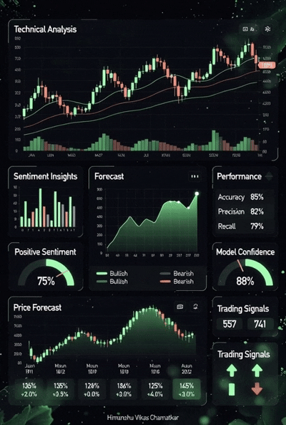
INTRODUCTION
This project, titled AI-Powered Stock and Options Prediction System, is an end-to-end Python framework that predicts the price movement (Buy/Sell/Hold) for stocks and indices listed in NSE/BSE and generates actionable option trading strategies.
This system will predict the stock trend by synthesizing these distinct data streams:
1. Technical & Structural Analysis: We will combine price momentum indicators Exponential Moving Average and Moving Average Convergence Divergence (RSI/MACD) with advanced Structural Analysis principles (FVG/Order Blocks) to capture real-time market imbalances and potential institutional movement.
2. Sentiment (News) Analysis: We will use VADER NLP to convert current news headlines into a quantifiable sentiment score, providing crucial context to technical signals.

Slide 6
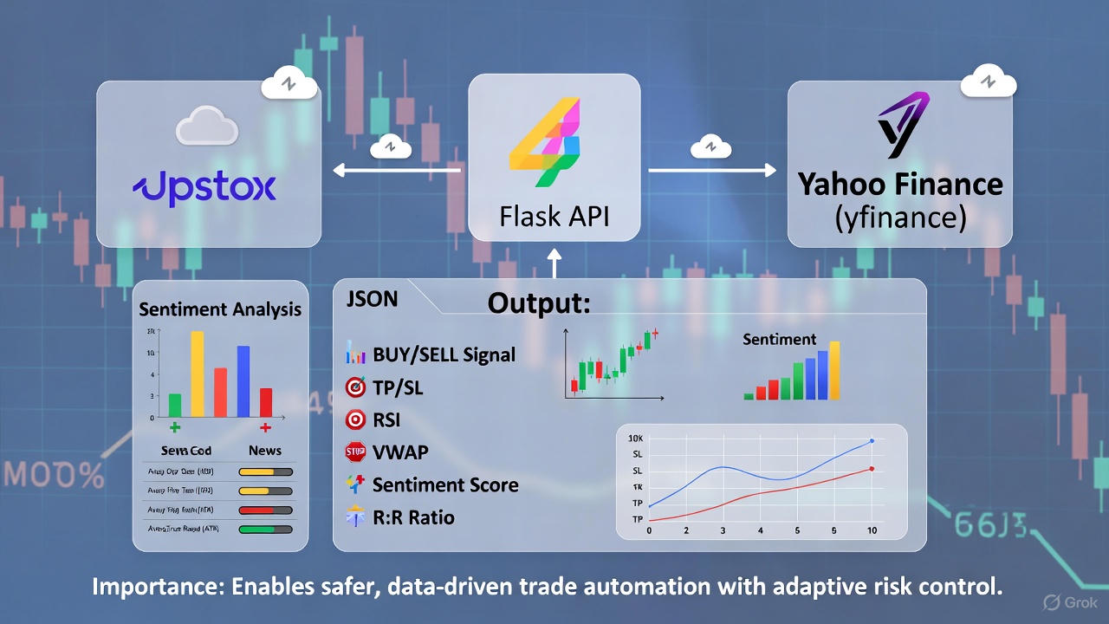
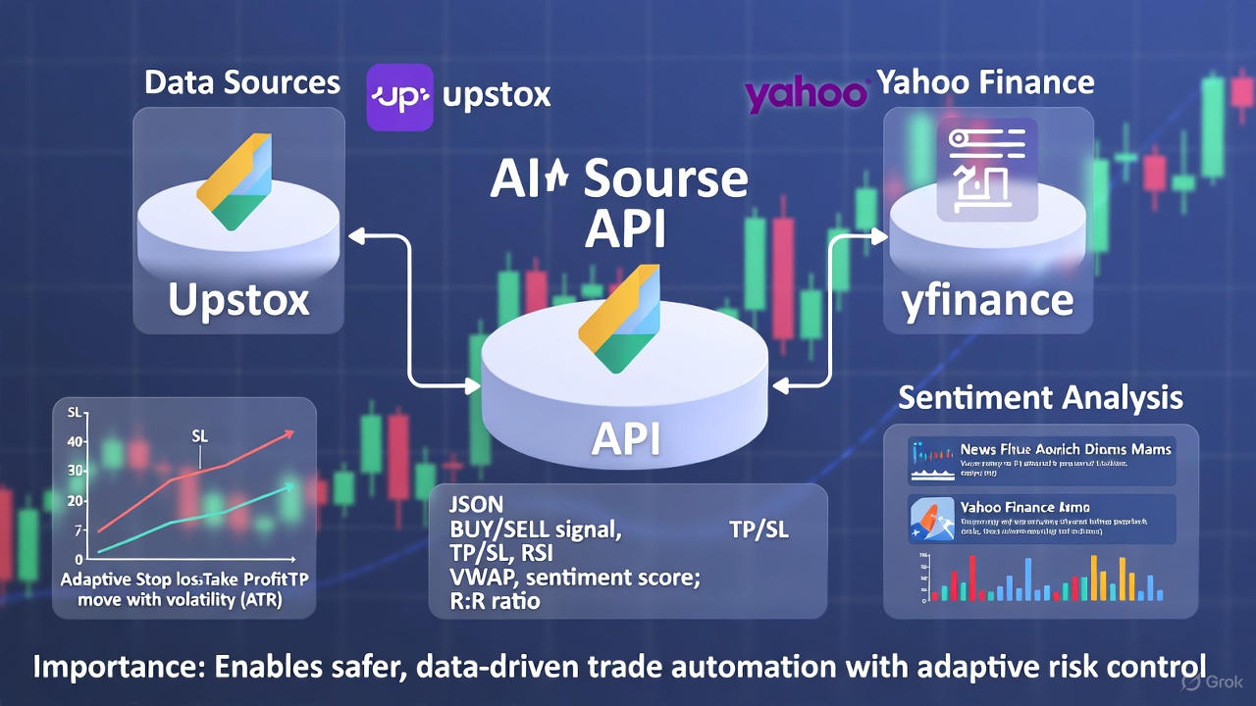

Slide 7
PRISMA CHART
Records identified through database searching (n=55) Sources: IEEE Xplore, ACM Digital Library, Scopus, Web of Science, Google Scholar
Additional records identified from other sources (n=5) ResearchGate, arXiv, institutional repositories, conference proceedings
Records after duplicates removed (n=50)
Records screened (n=50) Reviewed based on title, abstract, and keyword match with "AI stock prediction," "LSTM," "XGBoost," "options trading," "structural analysis," "smart money concepts," "FVG," "sentiment analysis," and "real-time financial forecasting."
Records excluded after abstract screening (n=30) Reasons: unrelated domains (e.g., medical imaging, pure theoretical economics without ML), conceptual papers without empirical ML implementation, non-equity asset classes (e.g., crypto, commodities only).
Full-text articles assessed for eligibility (n=20) Detailed PDF reviews to evaluate experimental models (XGBoost/LSTM), feature engineering (technical, structural, sentiment), options strategy integration, and real-time implementation
Full-text articles excluded with reasons (n=10):
Lacked ML/DL predictive model (e.g., pure statistical models) (n=3)
Focused only on long-term portfolio management without short-term prediction (n=2)
Did not integrate multi-modal features or an ensemble approach (n=3)
Review papers without a novel computational implementation (n=2)
(This leaves 10 papers for final inclusion, matching your requirement.)
Studies included in qualitative synthesis (n=10) These formed the final literature base covering ensemble AI models for stock prediction, multi-modal feature engineering (technical, structural, sentiment), and actionable options strategy development.

Slide 8
LITERATURE SURVEY
Sr.No | Title of the Article Author Year of publication | Focus of Study, Design, Objectives , Method used and Sample size | Findings of the study and their conclusions | Remarks of the Scholar
1. 2. | Title: Hybrid Machine Learning Models for Long-Term Stock Market Forecasting: Integrating Technical Indicators Author: Li, G. & Wang, L. Year: 2024 Title: Exploring Sectoral Profitability in the Indian Stock Market Using Deep Learning Author: Sharma, N. & Mehta, A. Year: 2025 | Focus: Enhancing stock prediction accuracy. Method: Integrates LSTM and CNN with Technical Indicators on S&P 500 data. Focus: Stock price prediction and portfolio design in India. Method: Optimized LSTM model utilized historical prices of 180 stocks across 18 sectors on the NSE to generate buy/sell signals. | Hybrid CNN-LSTM models significantly outperform traditional ML models (SVM, RF) by leveraging both temporal and spatial features. Optimized LSTM models demonstrate high efficacy in predicting future NSE stock prices and movement patterns. | High Relevance: Directly supports the use of Hybrid Deep Learning and Technical Indicators in the input set. Direct Relevance: Uses LSTM specifically on NSE, India data, confirming the model's viability for your target market.

Slide 9
Sr.No | Title of the Article Author Year of publication | Focus of Study, Design, Objectives , Method used and Sample size | Findings of the study and their conclusions | Remarks of the Scholar
3. 4. | Title: Fourier transform based LSTM stock prediction model under oil shocks Author: Ren, X., et al. Year: 2022 Title: Deep Learning for Short-Term Equity Trend Forecasting: A Behavior-Driven Multi-Factor Approach Author: Chen, S., et al. Year: 2025 | Focus: Improving stock volatility prediction accuracy by incorporating external macroeconomic factors. Method: Fourier Transform preprocessing combined with an LSTM model, using S&P 500 volatility data. Focus: Short-term stock return prediction using behavioral factors. Method: Evaluates MLP, CNN, and SVM models based on 40 technical signals (Multi-Factor) and behavioral alpha factors. | Fourier transform-based LSTM model is superior to competing models, showing that non-traditional data preprocessing can significantly enhance deep learning performance. Optimized LSTM models demonstrate high efficacy in predicting future NSE stock prices and movement patterns. | Methodological Relevance: Supports the idea of augmenting LSTM with complex, pre-engineered features (similar to your EV/Structural inputs). Machine learning models, particularly deep neural networks (MLP), outperform conventional factor models in capturing latent structures necessary for accurate short-term trend prediction.

Slide 10
Sr.No | Title of the Article Author Year of publication | Focus of Study, Design, Objectives , Method used and Sample size | Findings of the study and their conclusions | Remarks of the Scholar
5. 6. | Title: Multimodal Deep Fusion Model for Stock Trend Prediction Author: Al-Ajmi, S., et al. Year: 2024 Author: Ren, X., et al. Year: 2022 Title: Machine Learning Methods to Exploit the Predictive Power of Open, High, Low, Close (OHLC) Data Author: Mann, A. D. Year: 2024 | Focus: Combining diverse data types for robust prediction. Method: Multimodal Deep Fusion Architecture leveraging a BERT-based model branch (for sentiment) and an LSTM branch (for technical data). Focus: Developing novel data mining and ensemble techniques using basic OHLC features. Method: Ensemble using multiple LSTM RNNs and XGBoost trees, proposing Deep Candlestick Mining (DCM) (Structural Analysis proxy). | Deep fusion models combining technical data and BERT-based sentiment yield significantly higher predictive accuracy compared to single data modalities. A fusion of long-, medium-, and short-term information from LSTM and XGBoost models predicts market trend direction with high accuracy. | Direct Relevance: Directly validates your project's Multi-Modal/Ensemble strategy (Technical + Sentiment fusion). Direct Relevance: Directly validates the LSTM + XGBoost Ensemble approach using features derived purely from OHLCV structure (like your FVG/OB features).

Slide 11
Summary of Research Gap
Most existing research either focuses narrowly on one data type (e.g., pure technical indicators or pure news sentiment) or stops at predicting a simple direction. Our system bridges this gap by integrating three distinct data streams—Technical, Structural (FVG/Order Blocks), and Sentiment—to create a Multi-Modal Ensemble Model (XGBoost + LSTM). This comprehensive approach quantifies institutional footprints, making them usable by AI. Crucially, the system goes beyond a mere forecast (Buy/Sell) by translating the prediction into a concrete, risk-aware Estimated Options Strike Price, delivered with full transparency through a Streamlit Dashboard that displays all the underlying indicators simultaneously.

Slide 12
RESEARCH QUESTION
what extent does the integration of Structural Price Action Features (FVG, Order Blocks) and Sentiment Analysis with an Ensemble Model (XGBoost/LSTM) improve the accuracy?

Slide 13
AIM
Aim is to develop and implement a robust, end-to-end AI system to accurately forecast next-day stock trends (Buy/Sell/Hold) by integrating structural market analysis, Technical and sentiment data.

Slide 14
OBJECTIVES
To develop an AI-powered system that analyzes live stock market data and generates real-time BUY, SELL, or HOLD signals.
To integrate technical indicators and market sentiment analysis for improving the accuracy of trading decisions.
To automate calculation of target price (TP), stop loss (SL), and risk-to-reward ratio based on technical and structural patterns.
To design an interactive dashboard that visually presents trading insights, metrics, and performance in an easy-to-understand format.

Slide 15
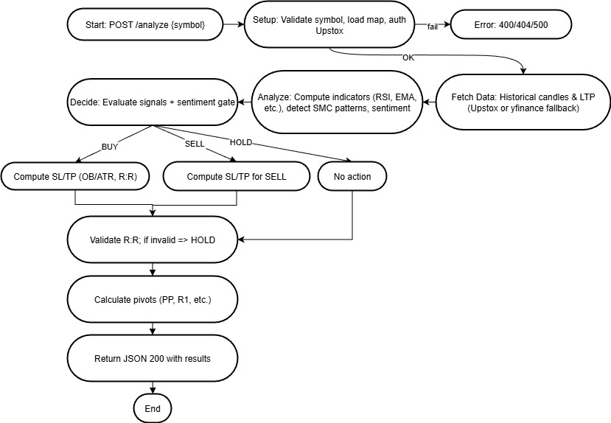
Methodology

Slide 16
Methodology
Data Collection The system collects real-time and historical stock market data using the Upstox API and Yahoo Finance (yfinance). If live data is unavailable, it automatically switches to fallback sources to ensure uninterrupted analysis.
Data Processing and Indicator Calculation The raw market data (Open, High, Low, Close, Volume) is processed using Python and pandas-ta to calculate key technical indicators such as RSI, EMA, VWAP, MACD, and ATR. These indicators form the base for pattern and trend identification.
AI-Based Analysis and Signal Generation The processed data is analyzed using a structured decision model that combines technical indicators, market structure concepts (like Fair Value Gaps and Order Blocks), and sentiment scores from recent financial news. Based on this combined logic, the system automatically generates a BUY, SELL, or HOLD signal along with Stop Loss, Target Price, and Risk-to-Reward metrics.
Result Compilation and Visualization The final analysis results are sent to the frontend dashboard through a Flask API. The dashboard displays all metrics, trend summaries, and confidence levels in a visually rich interface with charts, meters, and performance bars.

Slide 17
COMPLIANCE OF LAST PRESENTATION
Sr. No. | Compliance (Project Objective) | Action Taken (with tools/techniques) | Outcome
1. | Design and implement real-time market data & analysis backend | Developed a Flask-based REST API in Python. Integrated the Upstox Python SDK for live data and used Gzip/CSV processing to manage and filter a master list of over 8,300 NSE instruments. | A high-speed backend capable of fetching and processing live market data for ~1,600 liquid equity symbols on demand.
2. | Develop an intelligent trading decision engine (SMC/TA) | Implemented Smart Money Concepts (SMC) logic including Fair Value Gaps (FVG) and Order Blocks. Combined this with EMA-50 trend filtering, RSI momentum, and VWAP benchmarks using the pandas-ta library. | An automated engine that generates BUY/SELL/HOLD signals with structural Stop Loss (SL) and Take Profit (TP) levels based on real-time price action.
3. | Integrate AI-driven news sentiment analysis | Embedded an NLP engine using NLTK’s VADER SentimentIntensityAnalyzer. Used yfinance to scrape live news headlines for specific symbols to calculate a real-time sentiment score (0.0 to ±1.0). | Signals are now filtered by AI sentiment, ensuring technical buy signals are backed by positive fundamental news context.
4. | Build a professional, high-performance trader dashboard | Created a responsive Dark Mode frontend using HTML5, Tailwind CSS, and Lucide icons. Implemented dynamic SVG gauges for model confidence and interactive cards for trade management. | A professional-grade web interface that allows traders to instantly view signals, risk-to-reward ratios, and structural pivot levels in a high-contrast, data-rich environment.

Slide 18
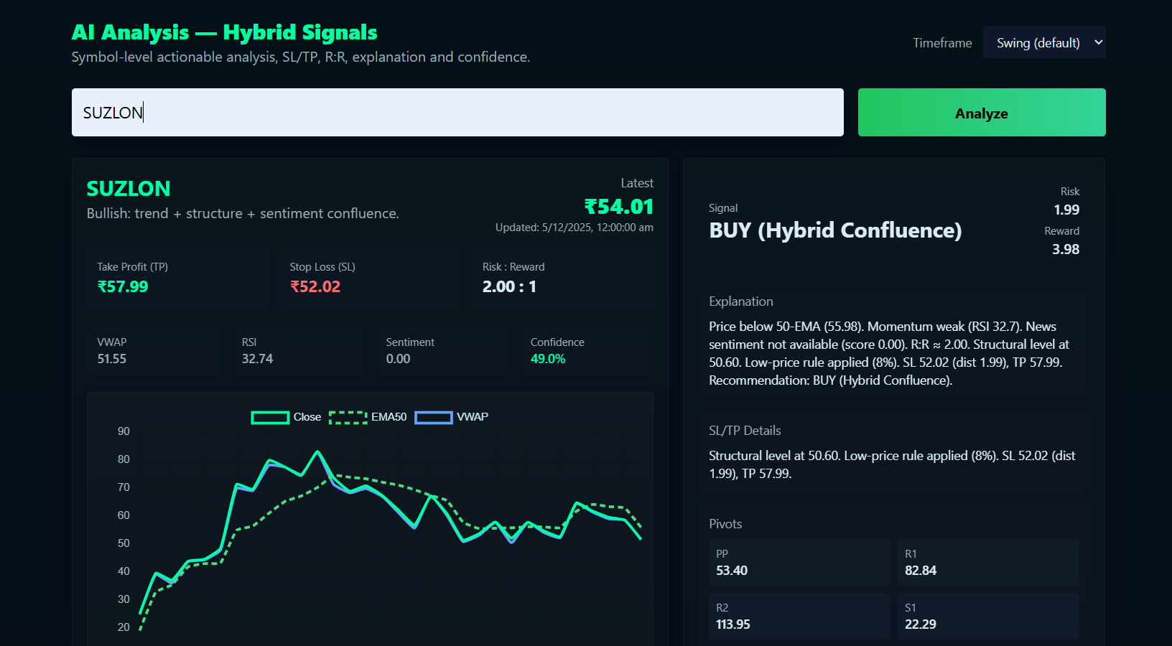
Result

Slide 19
References
[1] G. Li and L. Wang, "Hybrid Machine Learning Models for Long-Term Stock Market Forecasting: Integrating Technical Indicators," Preprints, 2024.
[2] N. Sharma and A. Mehta, "Exploring Sectoral Profitability in the Indian Stock Market Using Deep Learning," ResearchGate, 2025.
[3] X. Ren, W. Xu, and K. Duan, "Fourier transform based LSTM stock prediction model under oil shocks," Quant. Finance Econ., vol. 6, no. 2, pp. 342–358, 2022.
[4] S. Chen, Y. Luan, and P. Liu, "Deep Learning for Short-Term Equity Trend Forecasting: A Behavior-Driven Multi-Factor Approach," arXiv preprint arXiv:2508.14656, 2025.
[5] S. Al-Ajmi, A. Basak, and S. Sarkar, "Multimodal Deep Fusion Model for Stock Trend Prediction," ResearchGate, 2024.
[6] A. D. Mann, "Machine Learning Methods to Exploit the Predictive Power of Open, High, Low, Close (OHLC) Data". University College London, Doctoral dissertation, 2024.

Slide 20
Thank You

